Slide 1
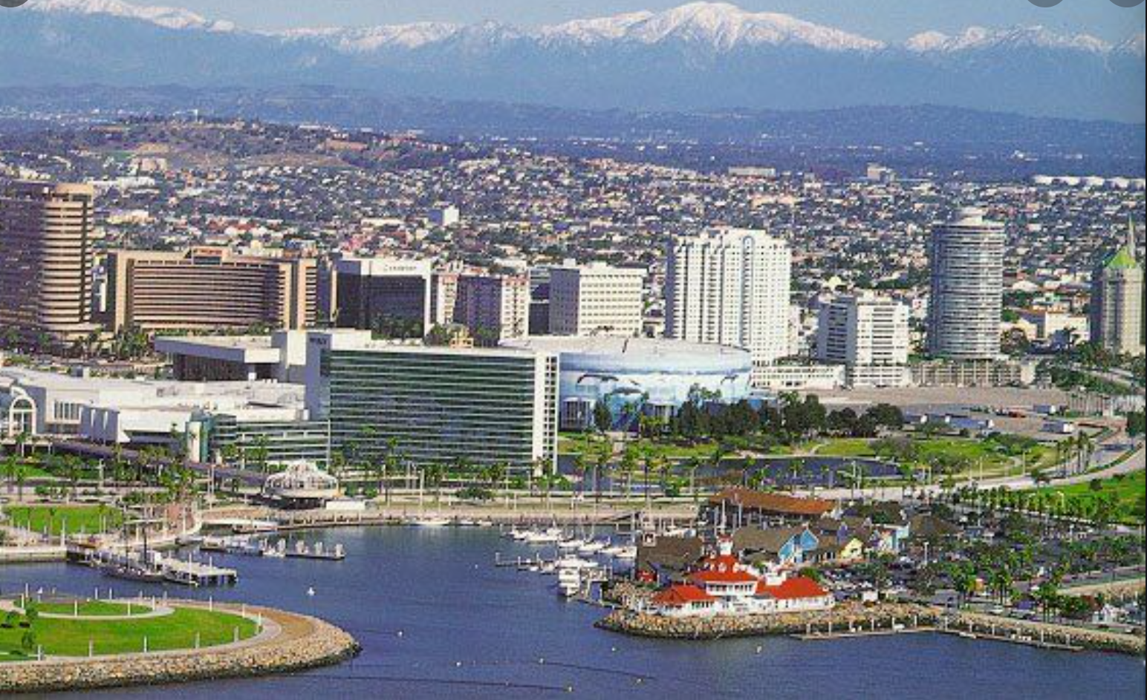
How Did the COVID-Pandemic Impact Water Usage in Long Beach, CA?
By: Ensieh Bahrami

Slide 2

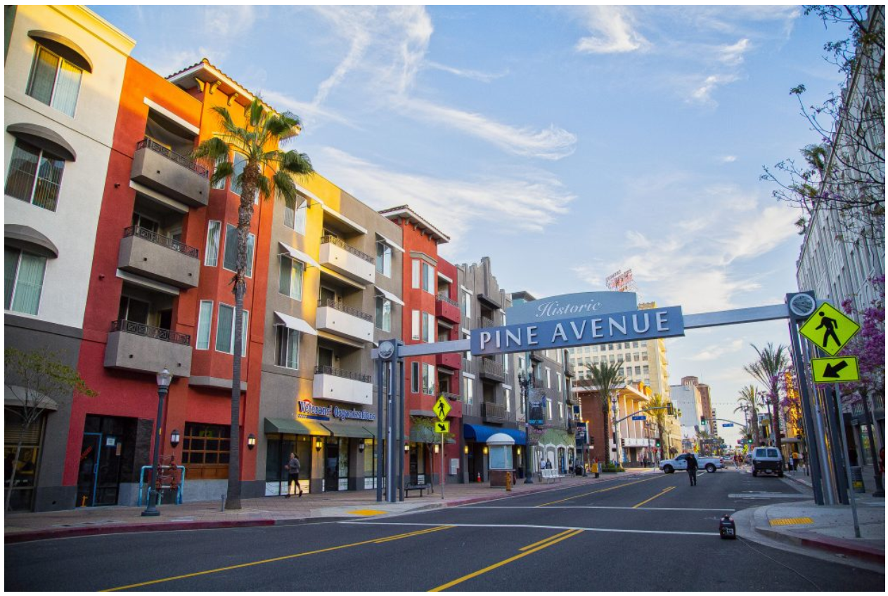


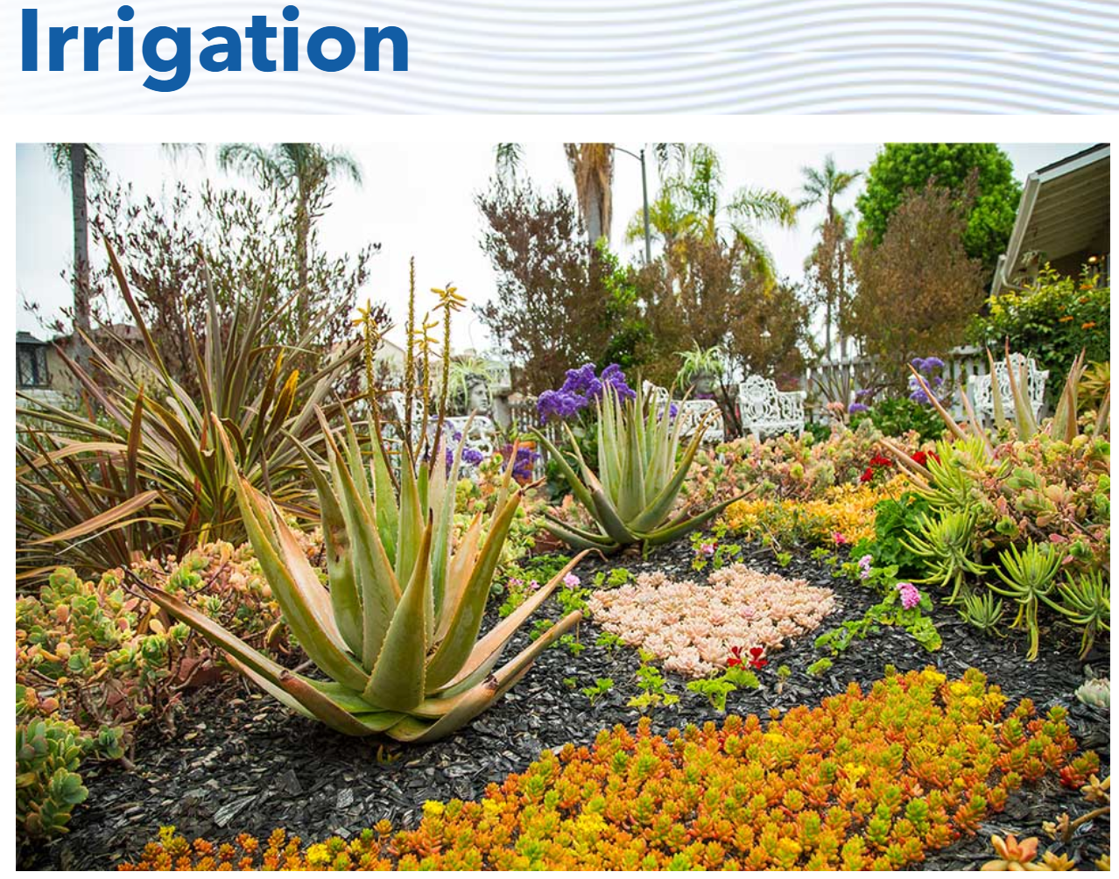

Status Qua
Water usage by 6 type of customers within three years (2017 - 2020)
Water Department
Find effective ways to provide reliable water supply
Customers
Mange their usage and save on water bills
Government
Effectively allocate budget to provide the required Facilities
Problem
Did COVID-Pandemic affect water usage?
What factors affects water consumption?
Can I predict water usage during the pandemic?
Notes:
Observing and predicting water usage, help water department find effective ways to provide reliable water supply
Informing customers from the average usage of their group help them to manage their usage

Slide 3
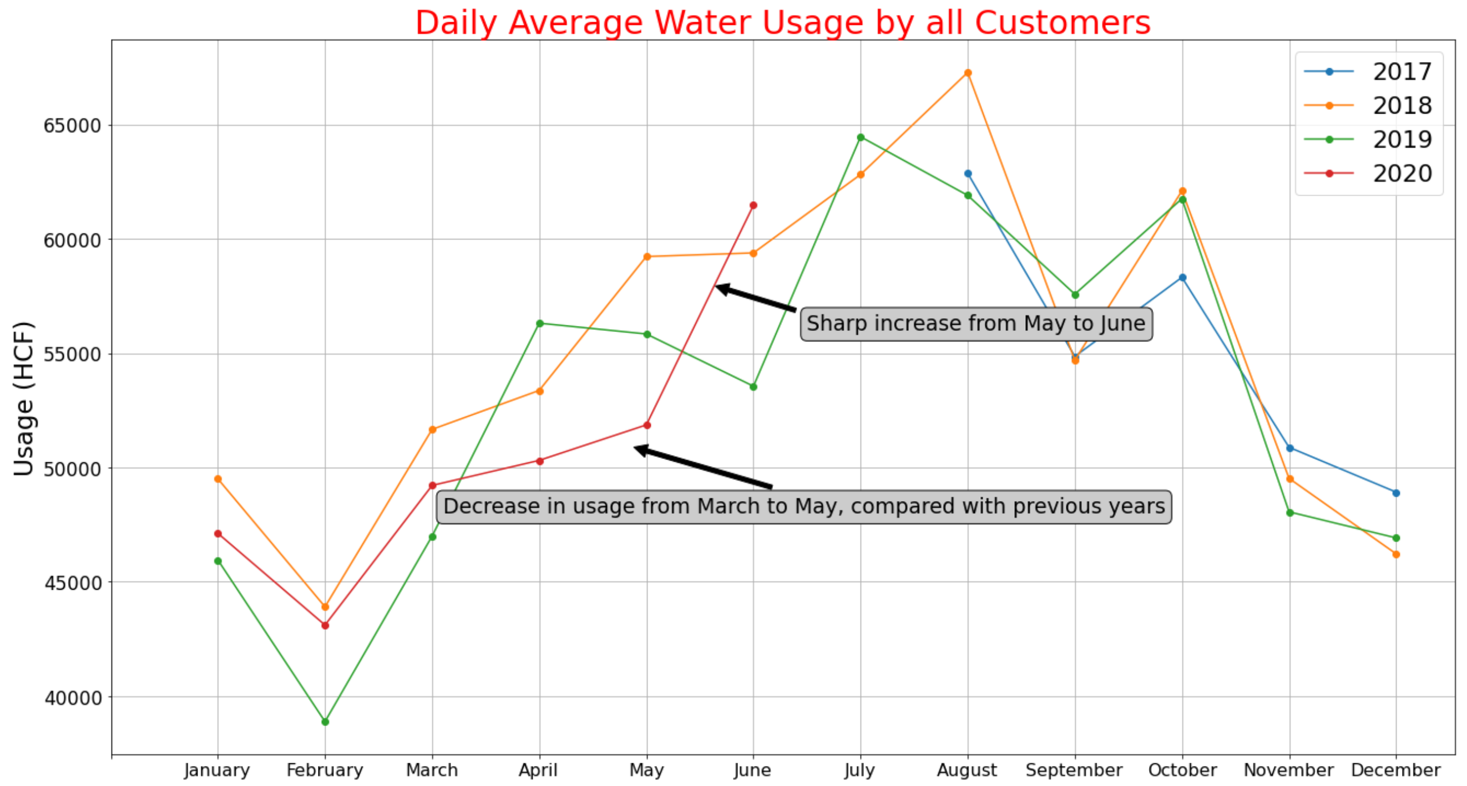
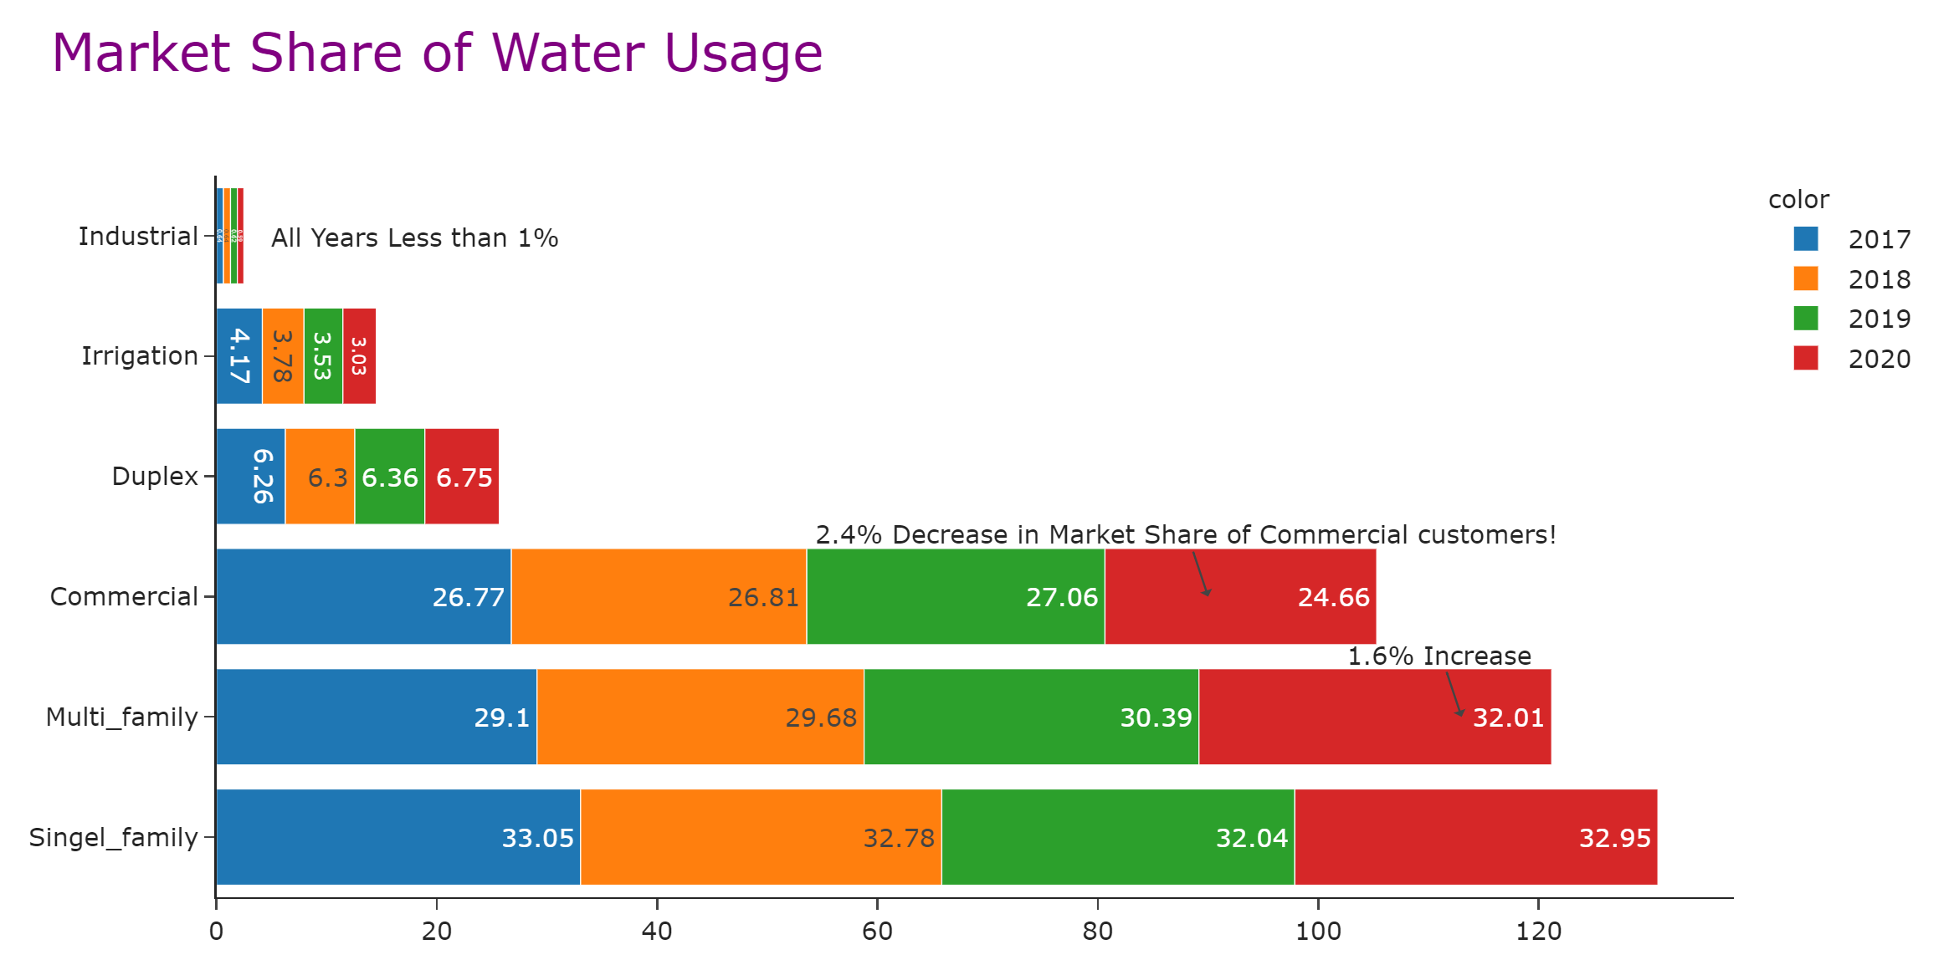
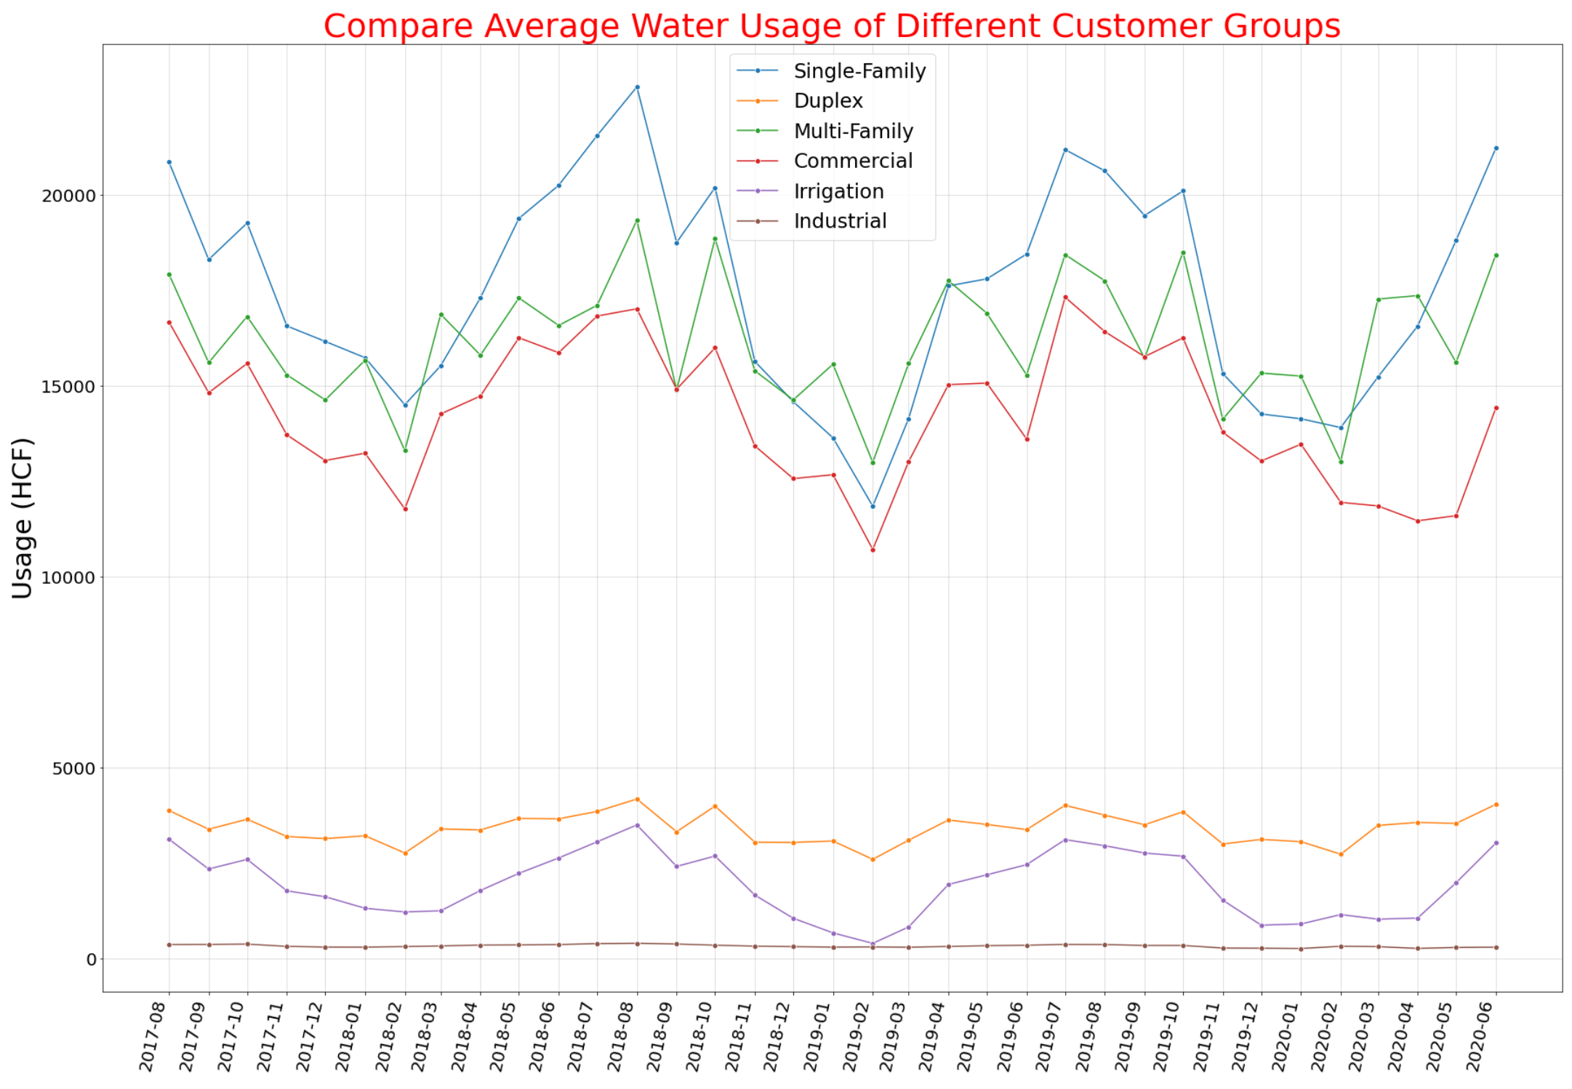
Key Findings
Approximately 80,000 customers
Notes:
Normalize usage for each customer group :
Divide monthly usage by number of days in the month, then divide by number of dwellings in that month
Average daily usage in Feb 2018,2019 and 2020 were the minimum. The reason might be related to number of days in Feb (Feb 2017,2018,2019 had 28 days and Feb2020 had 29 days).
June and July demonstrate the relatively high usage in years of 2017,2018 and 2019, the increase in water consumption is due to summer season. Also, Nov, Dec and Feb show decrease in usage,so there is a seasonality.
In 2020, water usage decreased from March 2020 and continue until June compared with similar months in previous years.
Besides seasonality, there is a trend that seems it is not kept in 2020.

Slide 4
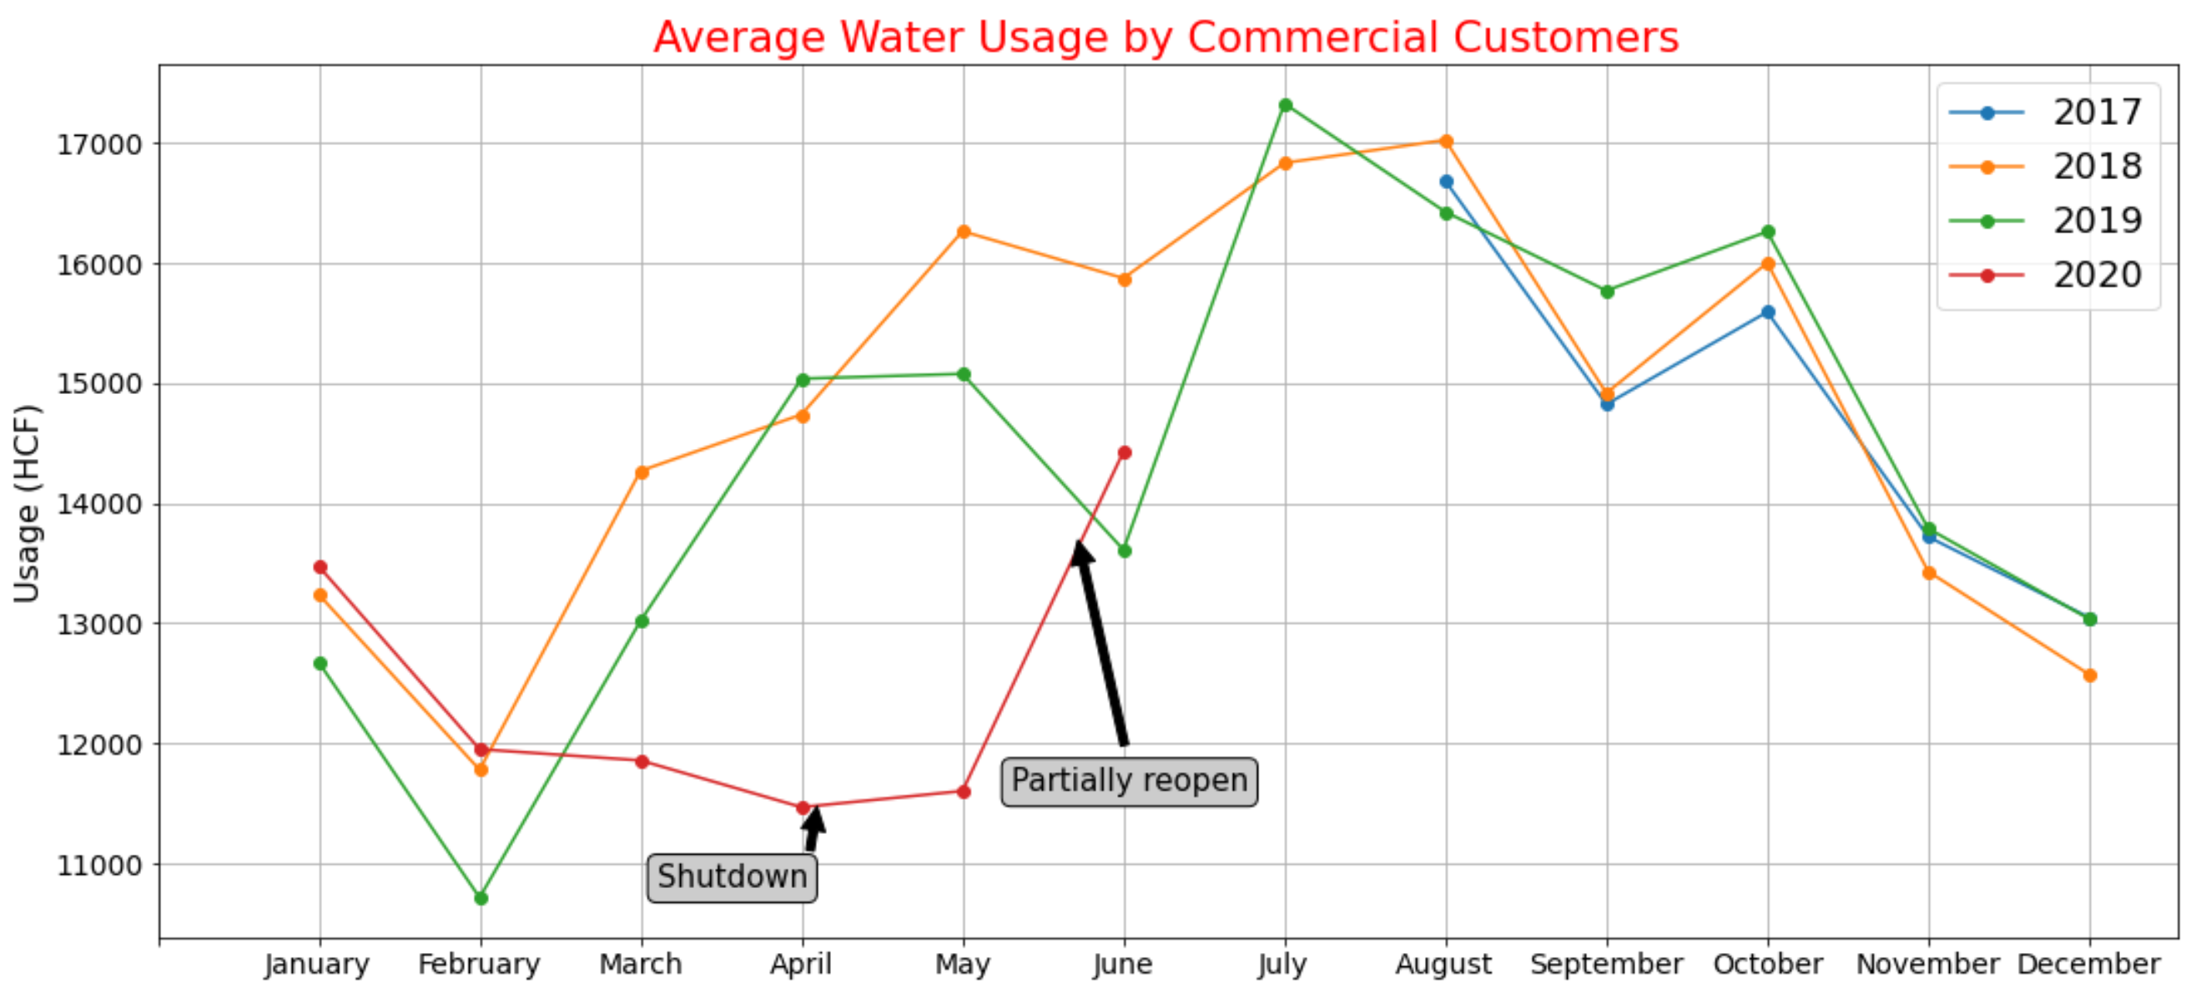
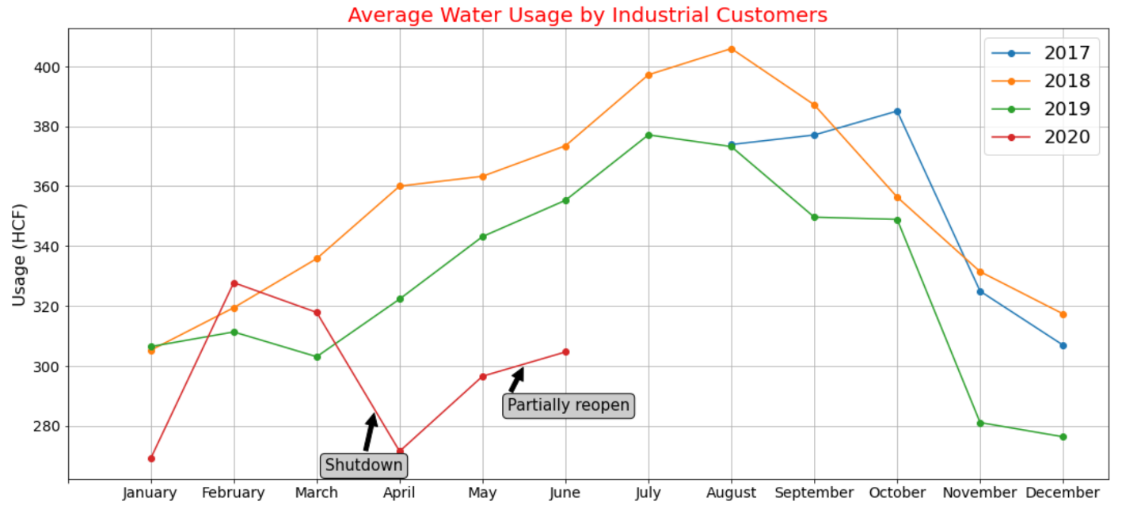
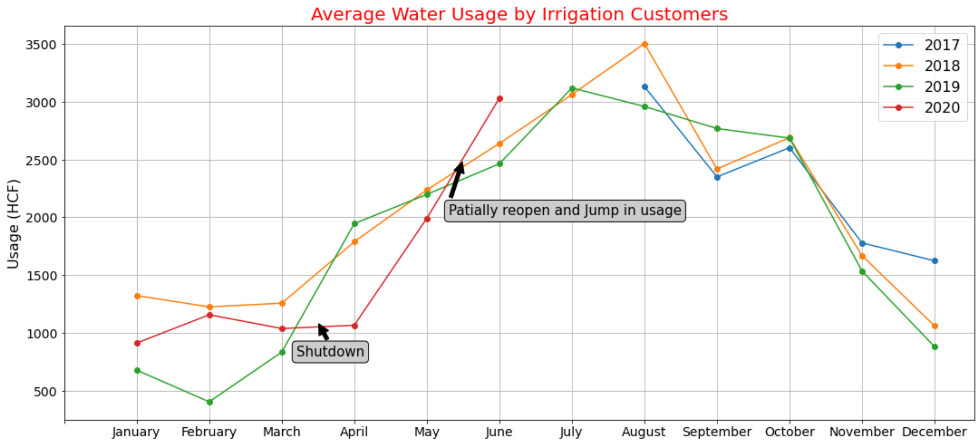
Key Findings on Non-Residential Customers
Shutdown and sharp drop in April and May
Reopen and usage jump in June

Slide 5
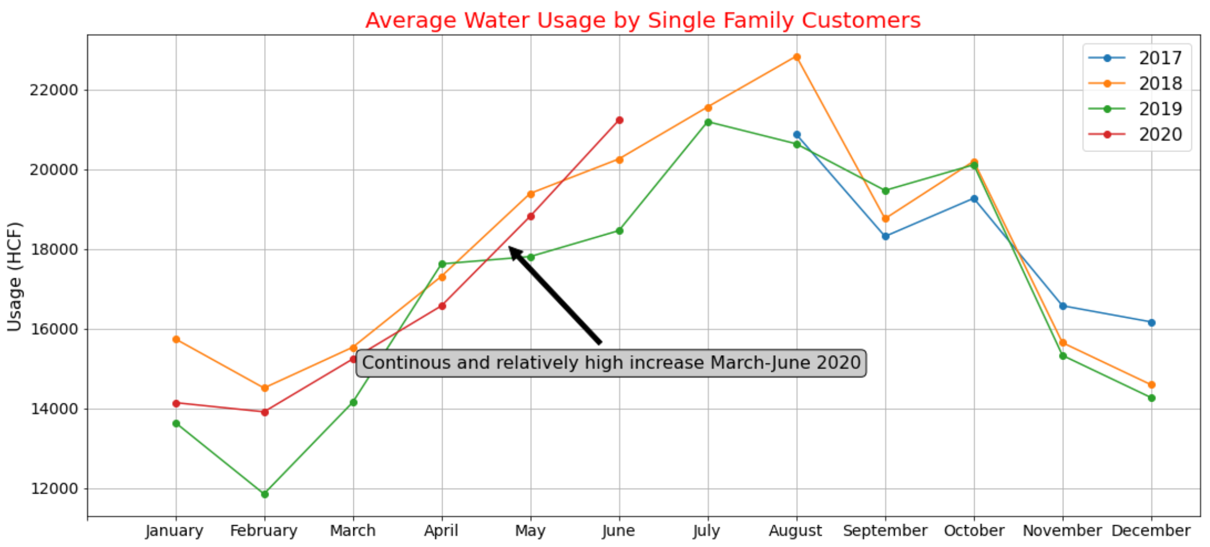
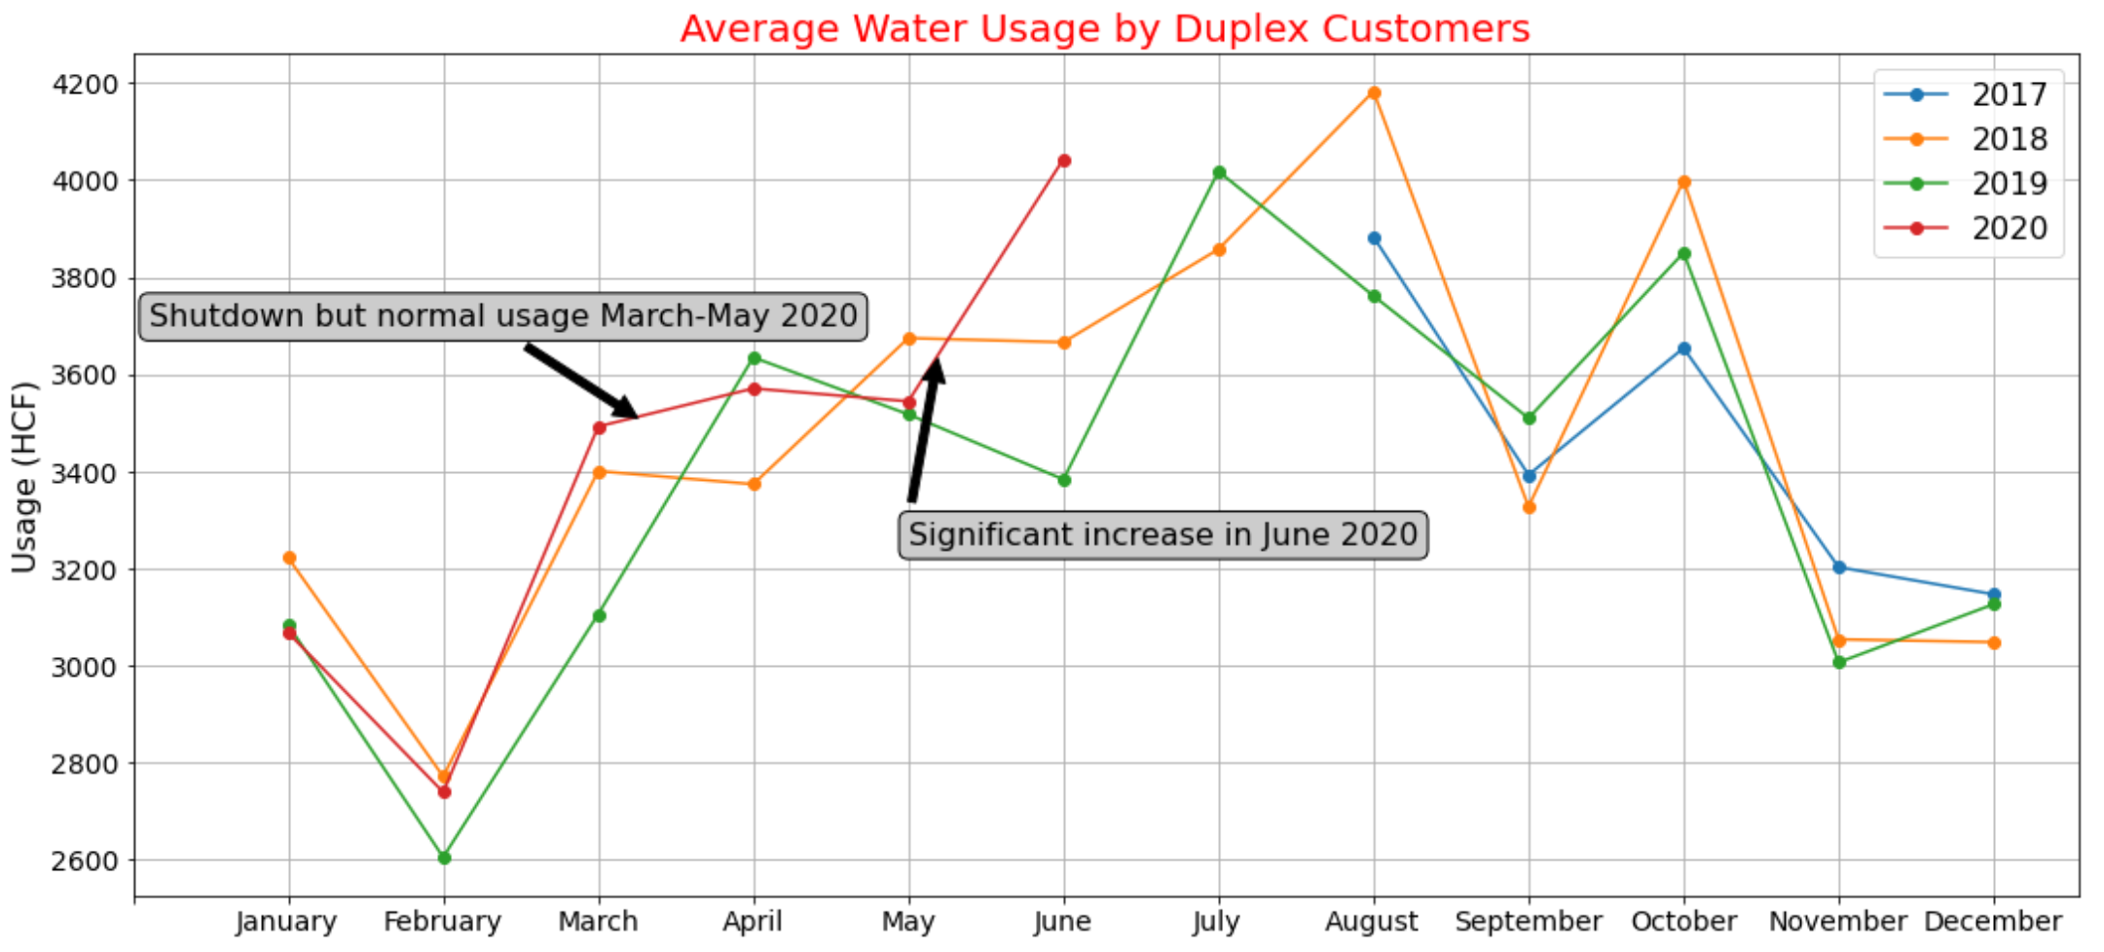
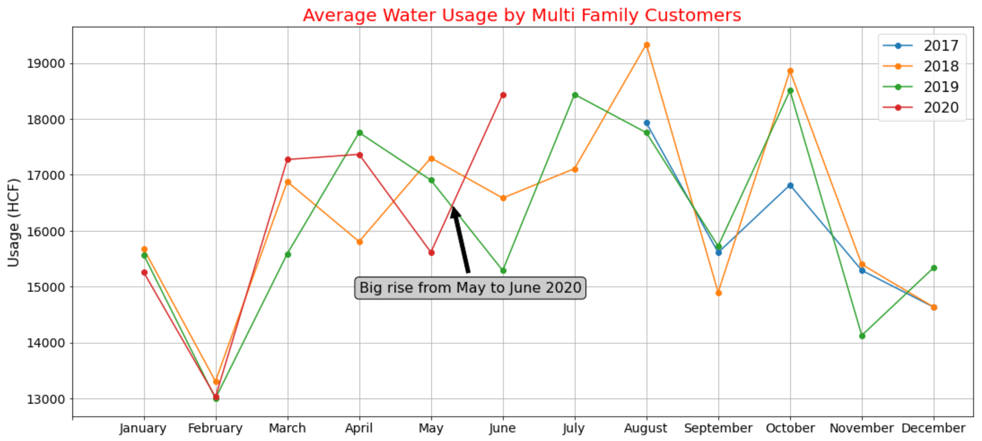
Key Findings on Residential Customers
Single family kept its trend
Multi family and duplex:
Normal increase from March to May
Decrease in May
Grow in June
Notes:
No Significant Decrease in Residential Usage in 2020

Slide 6
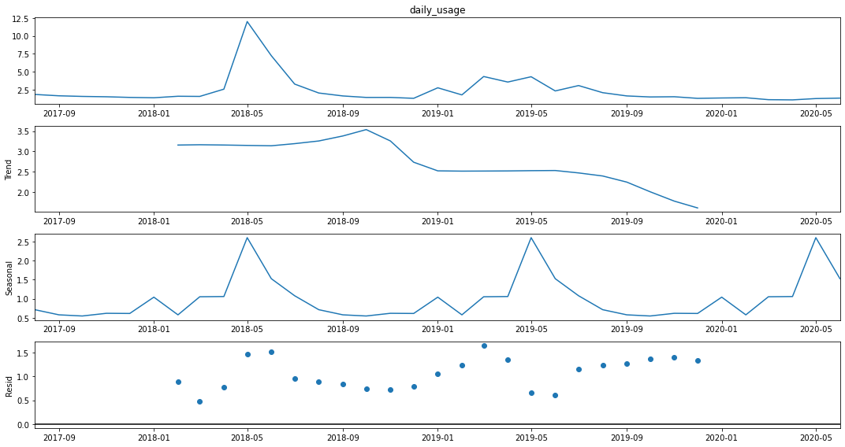
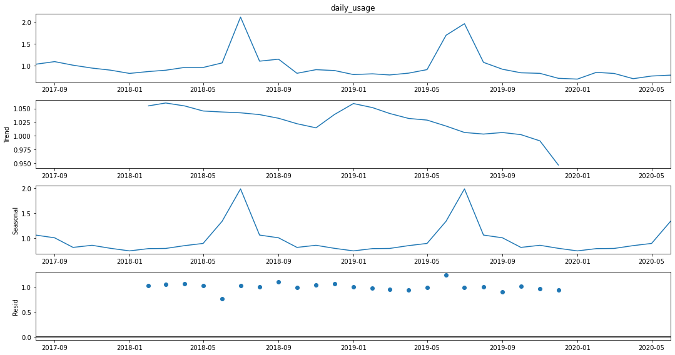
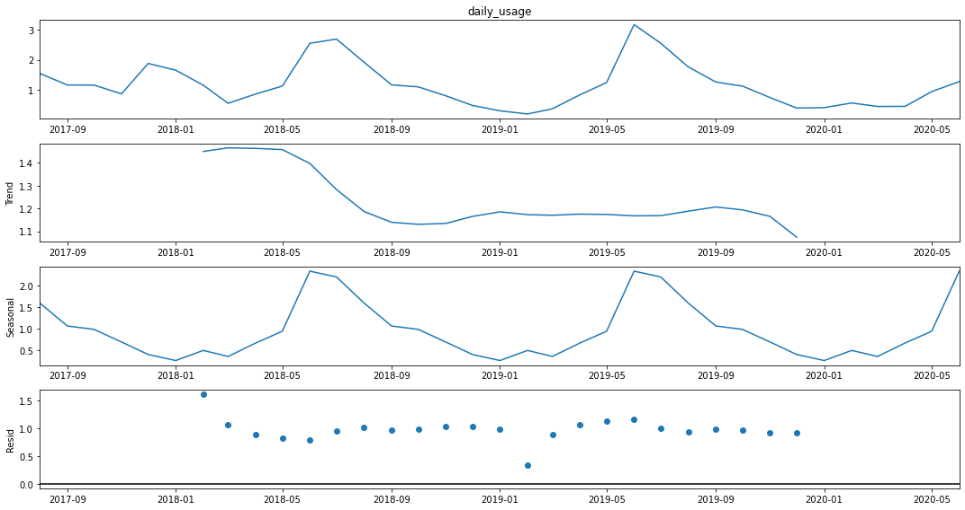
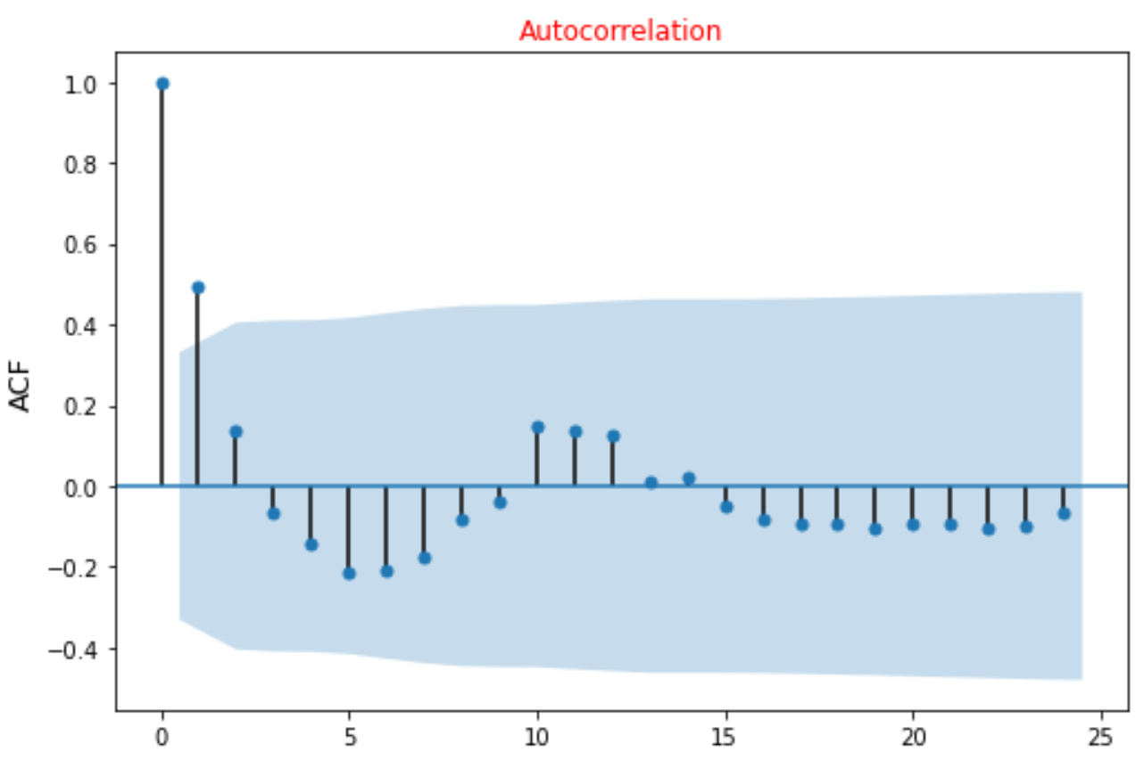
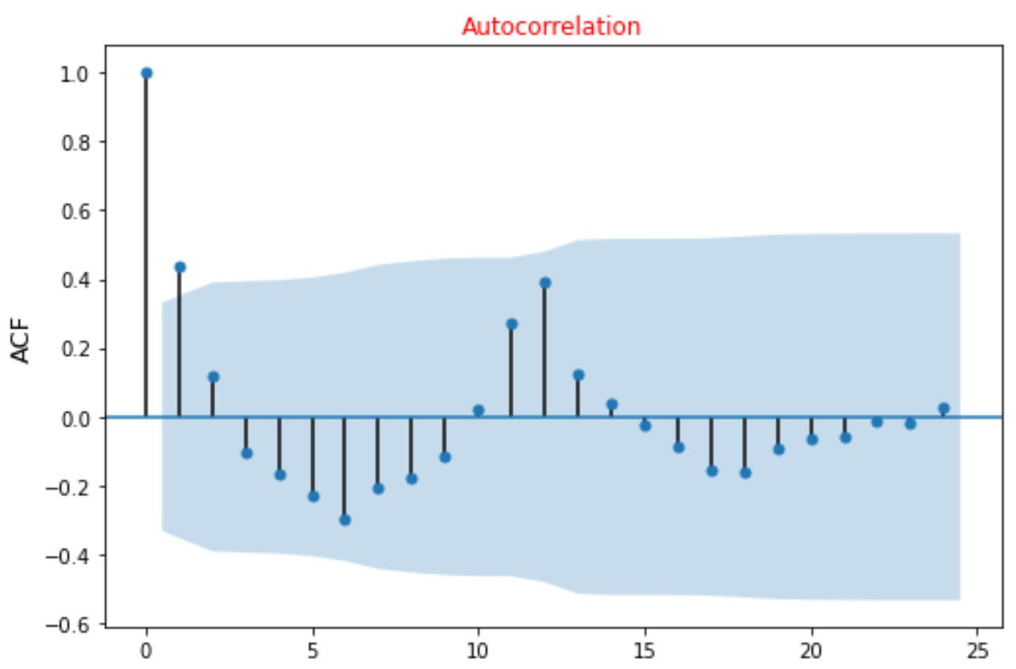
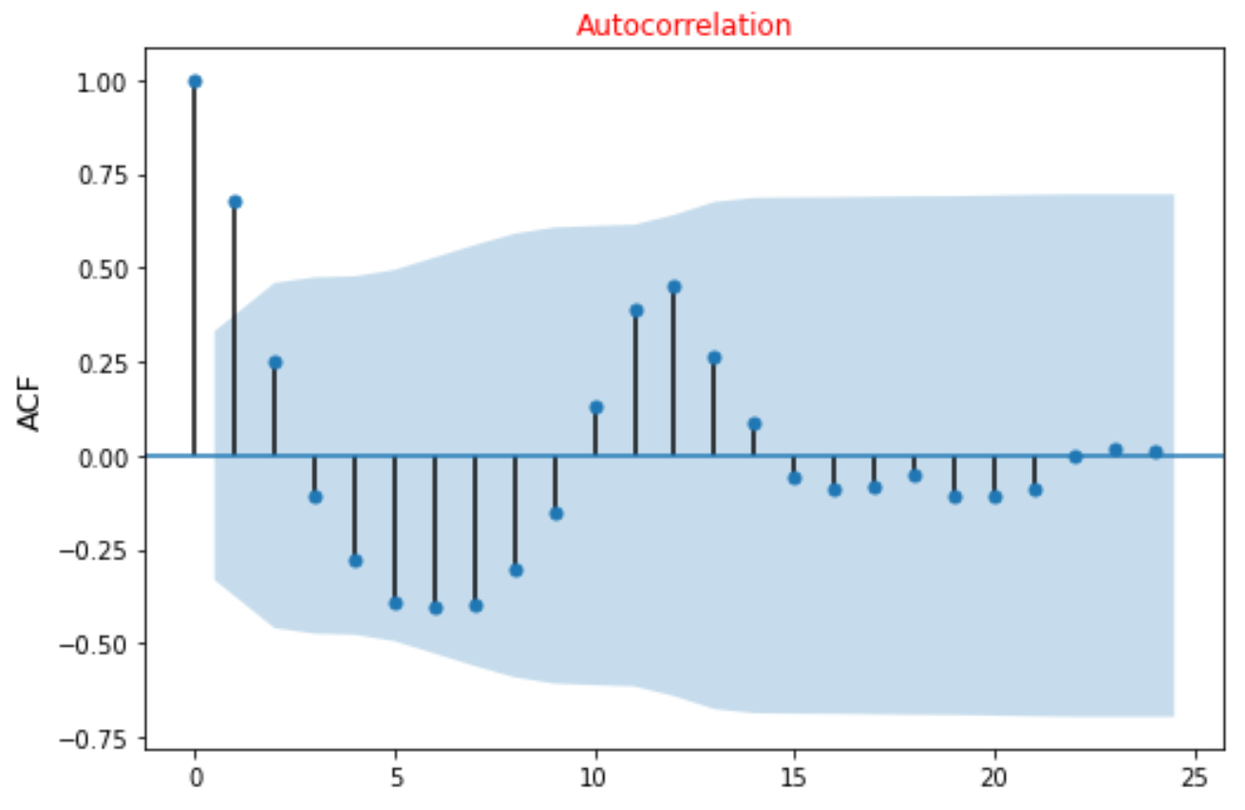
 | Commercial Group | Industrial Group | Irrigation Group
Daily Usage
Trend
Seasonal
Resid
Not a white noise, but non-stationary time series
Notes:
Check trend
Usage trend in commercial, industrial and irrigation groups are slightly different. But all have almost a trend with a negative slope
Check white noise
All three non-residential time series were not a white noise
Check stationary
Time series dataset is stationary if its statistical features don't change over time (constant mean, variance, and covariance)
All three non-residential time series were Not stationary based on Dicky-Fuller Test

Slide 7
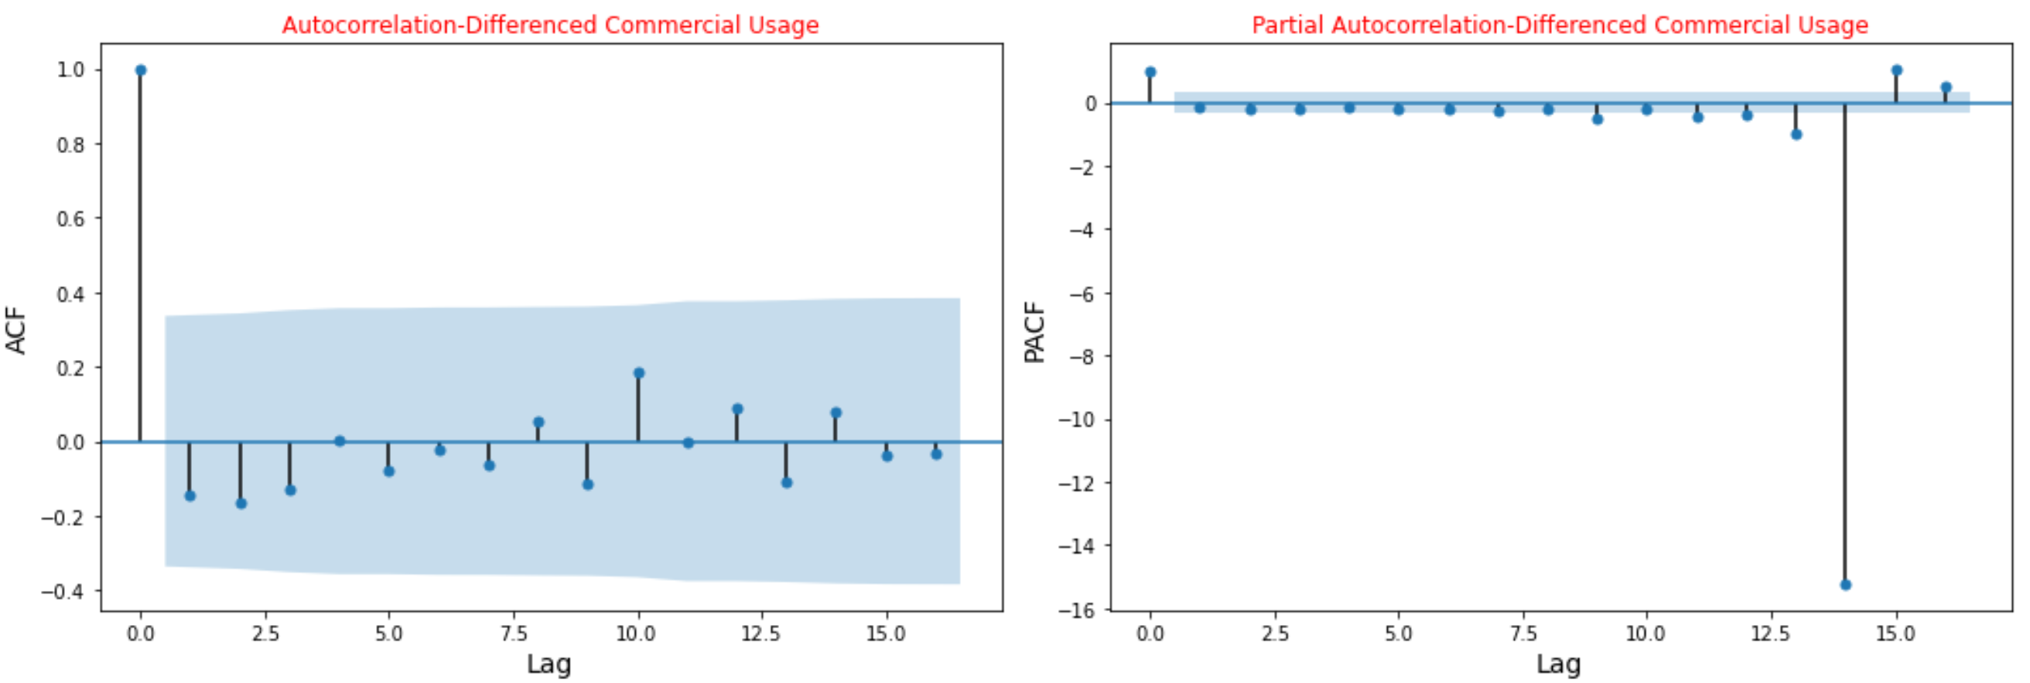
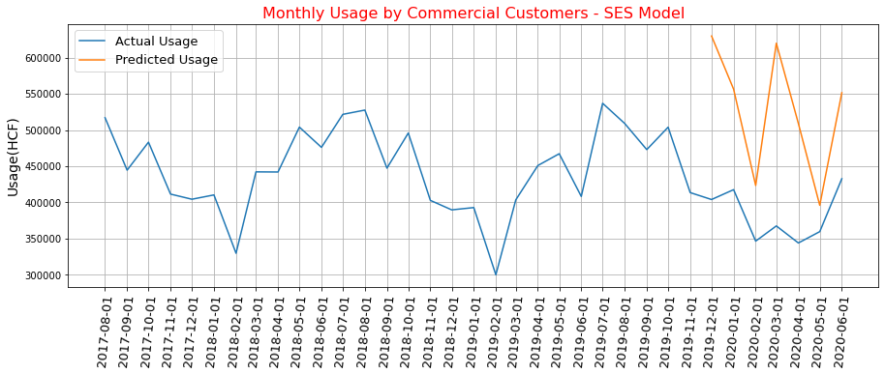
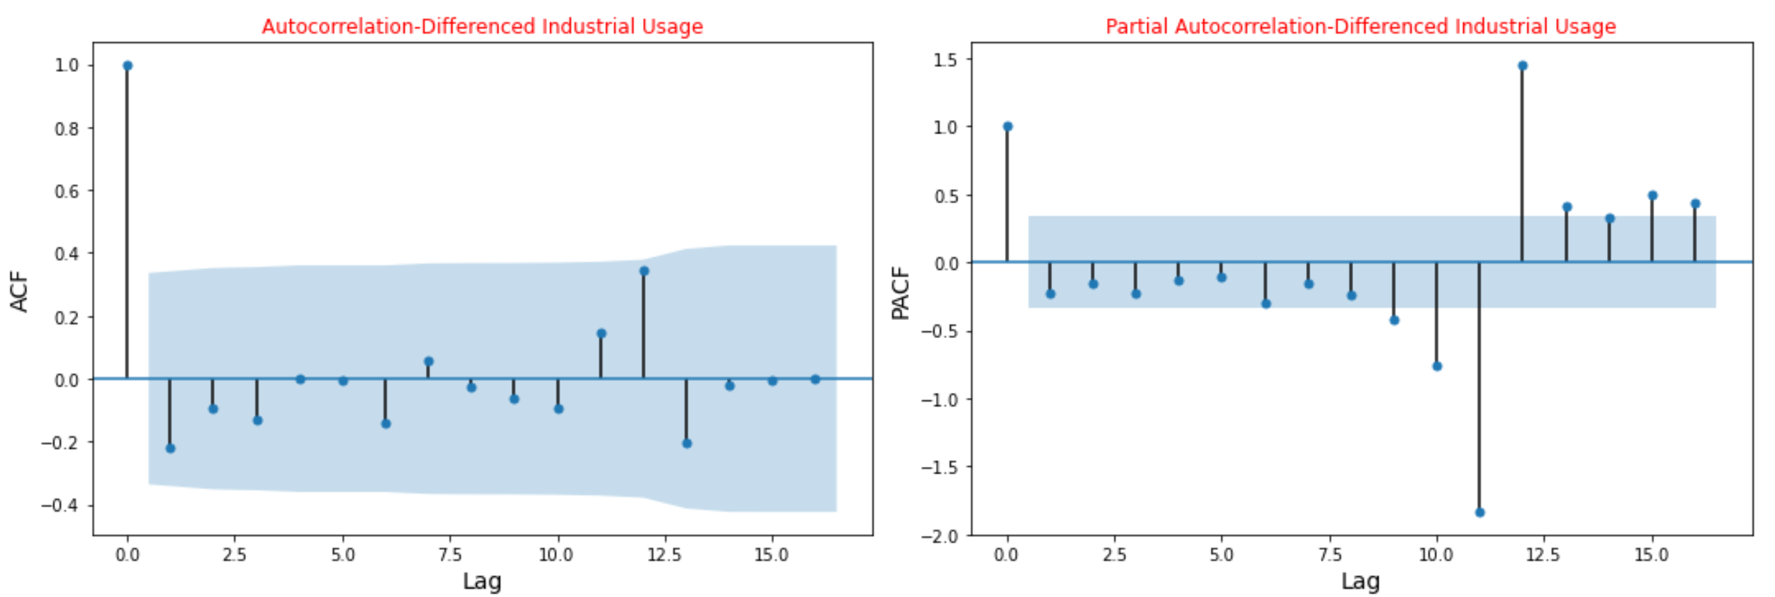
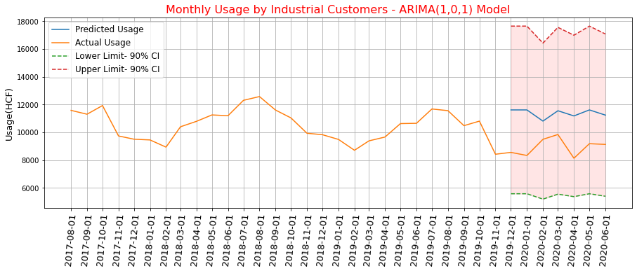
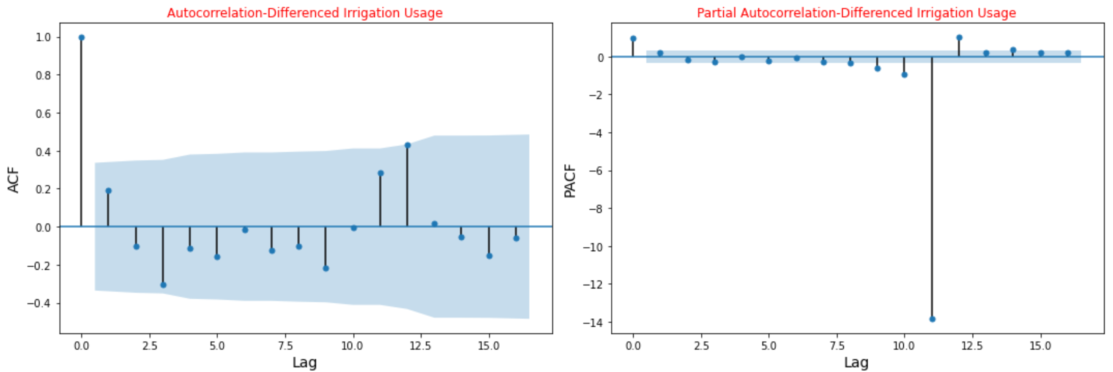
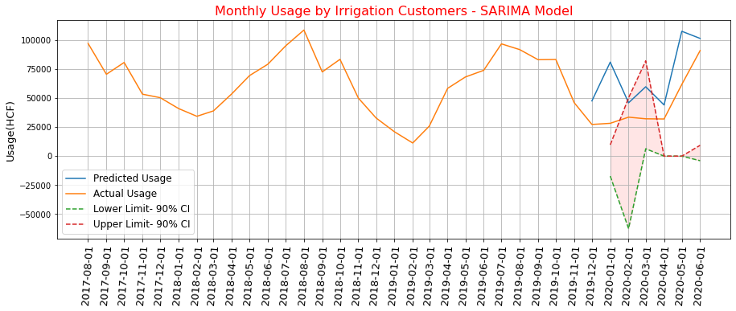
Commercial Group
Industrial Group
Irrigation Group
Notes:
usage difference of order one became staionary.

Slide 8
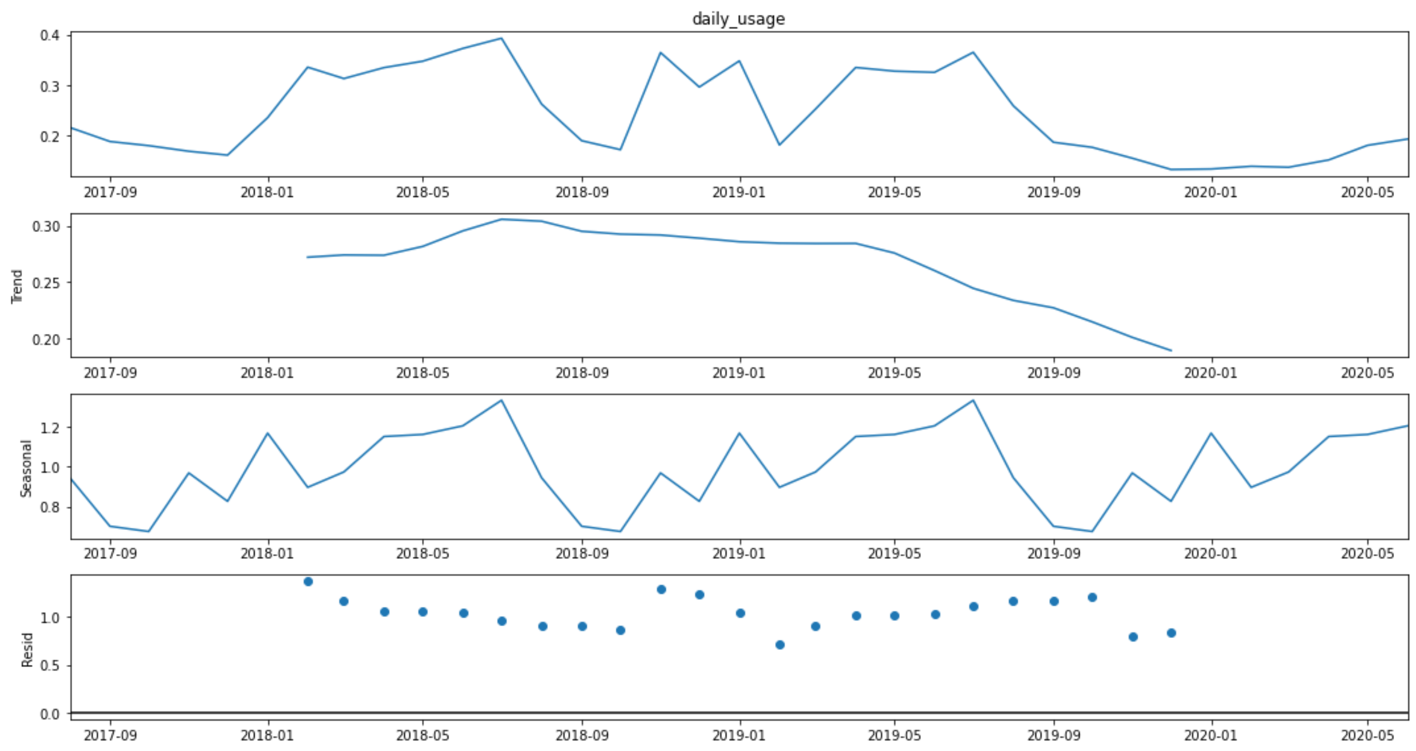
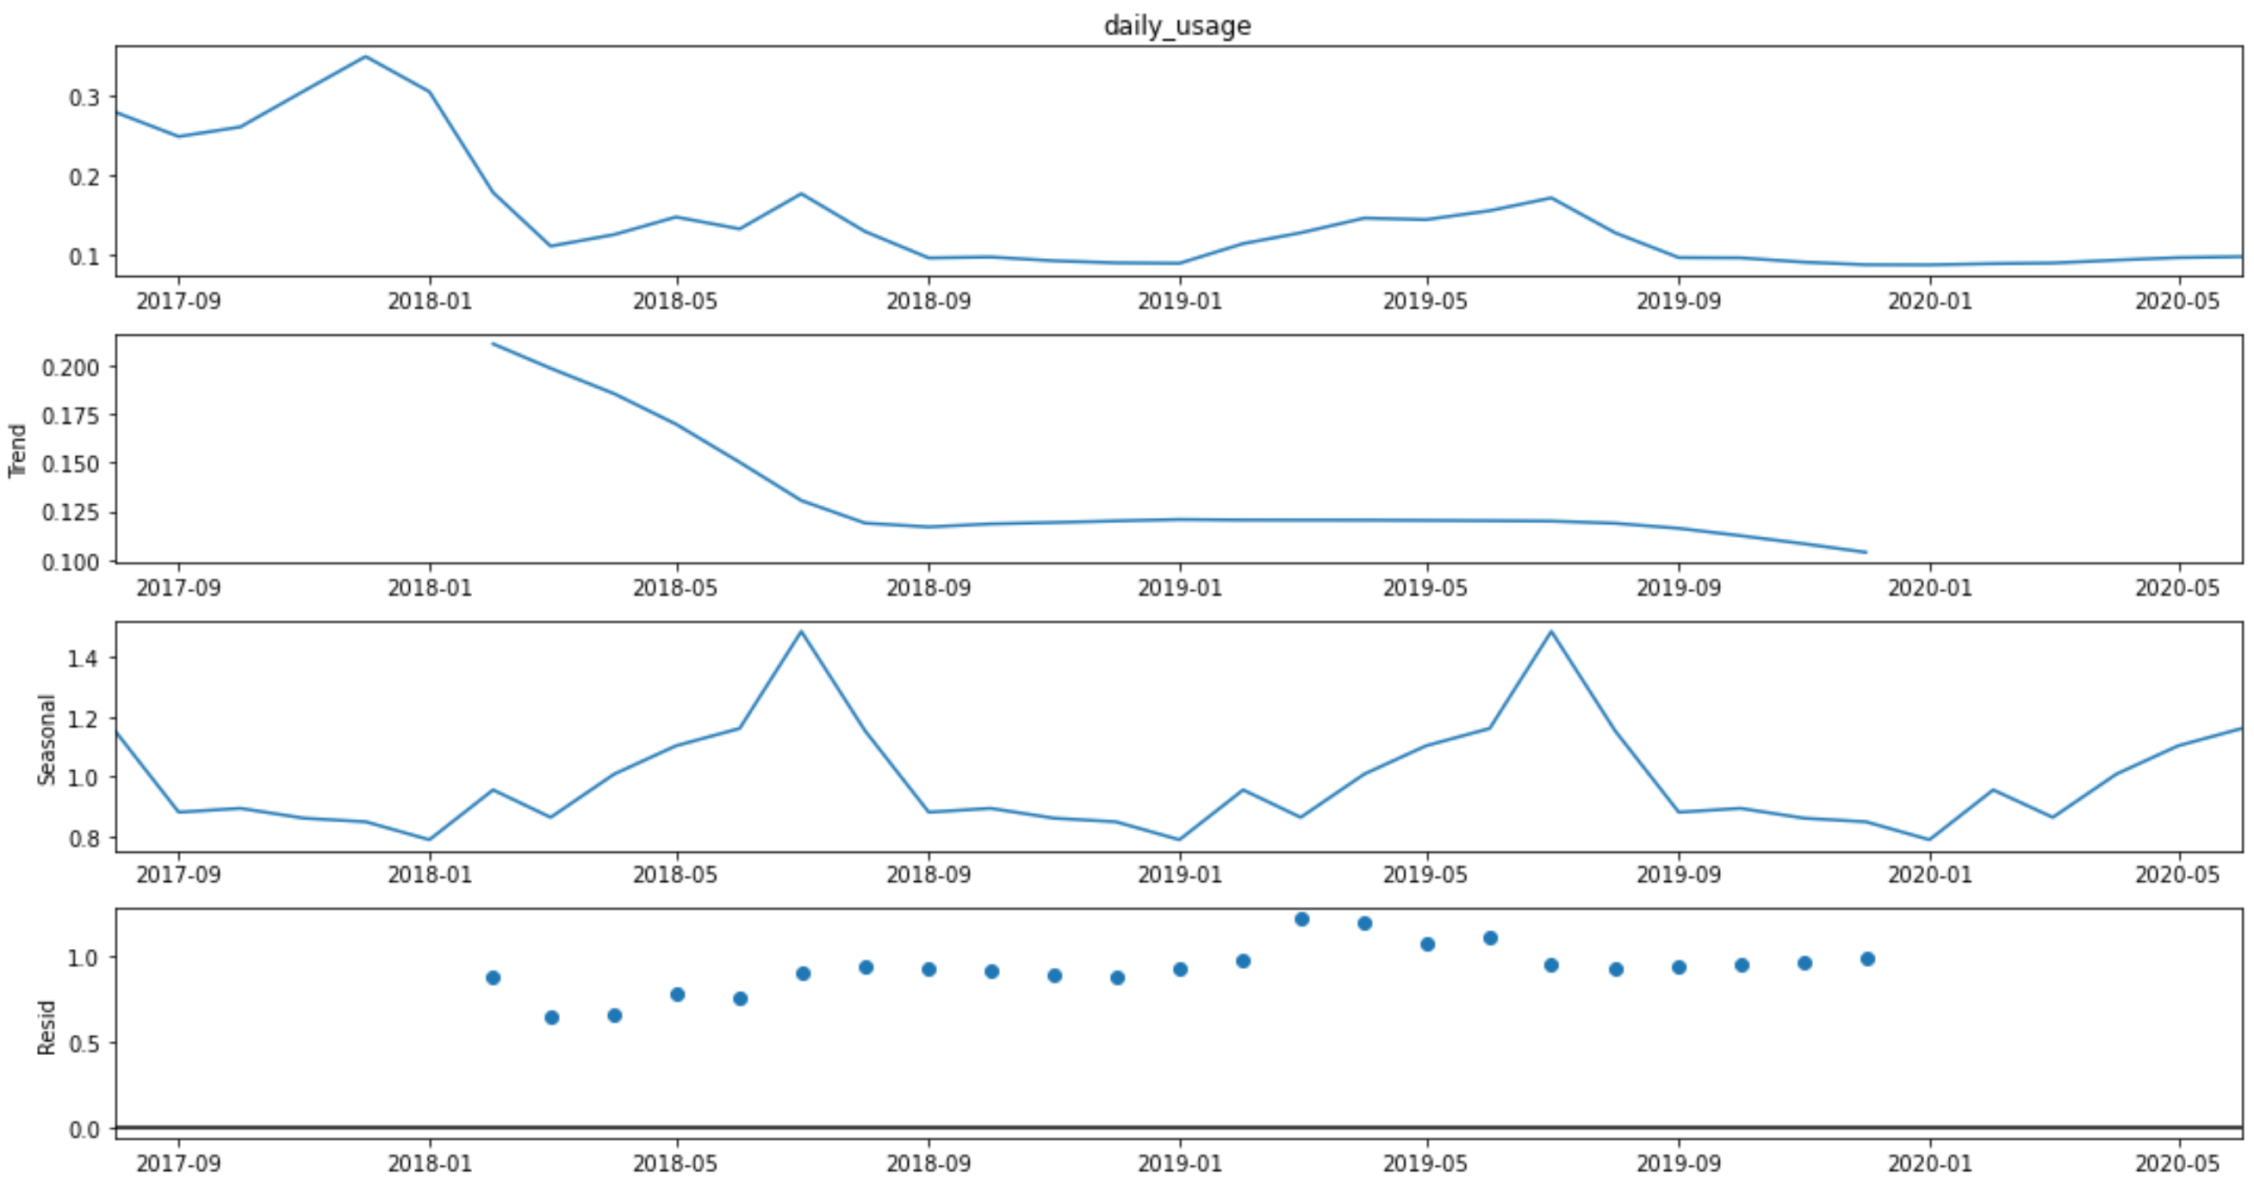
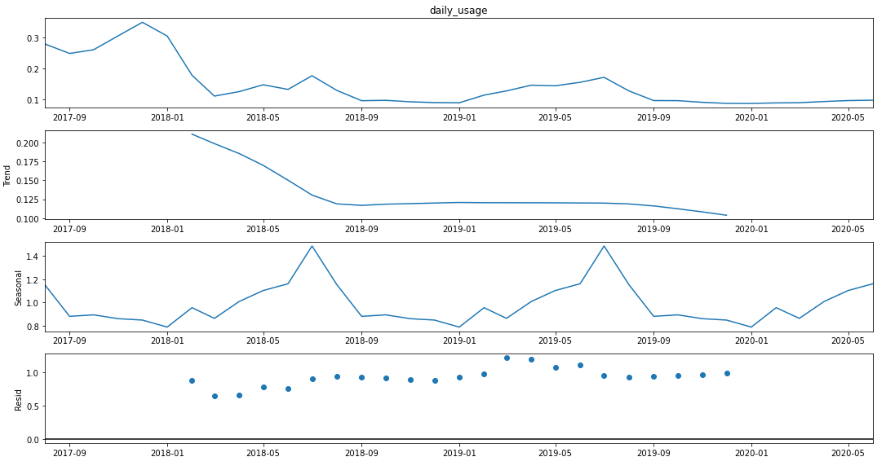
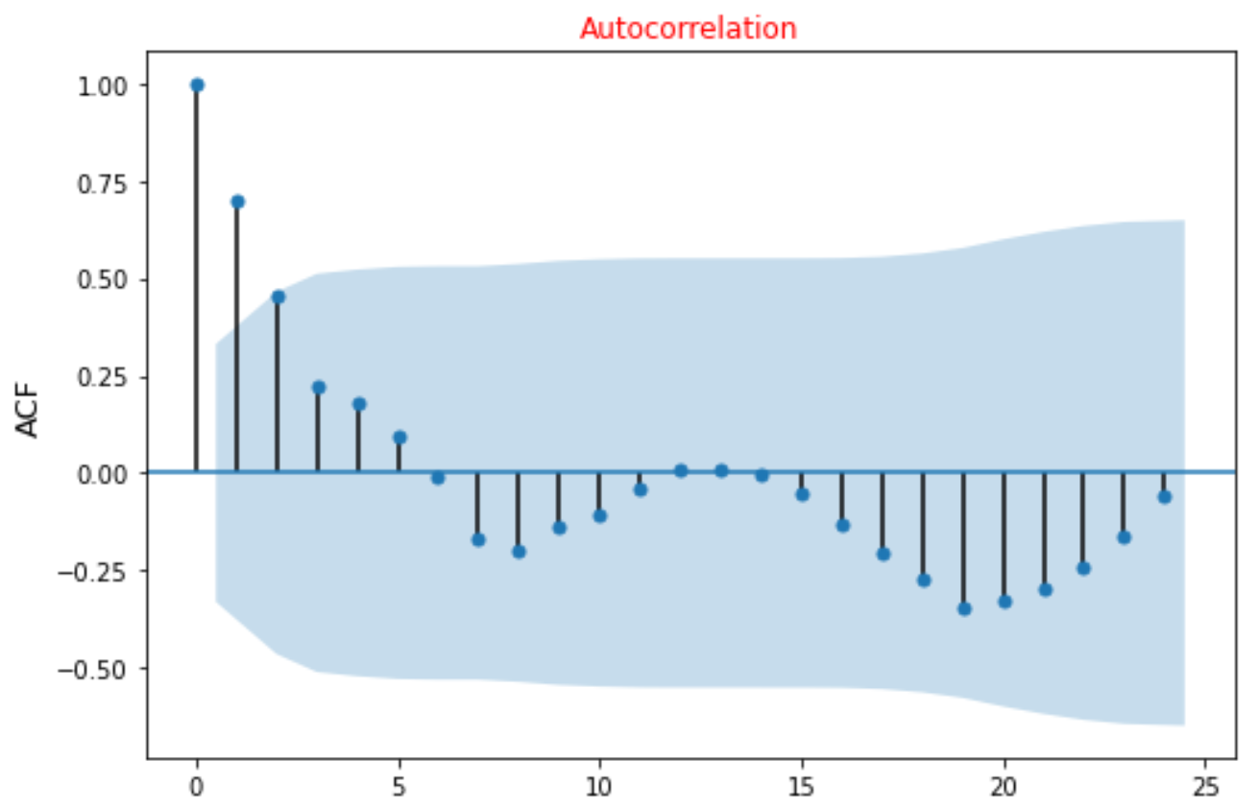
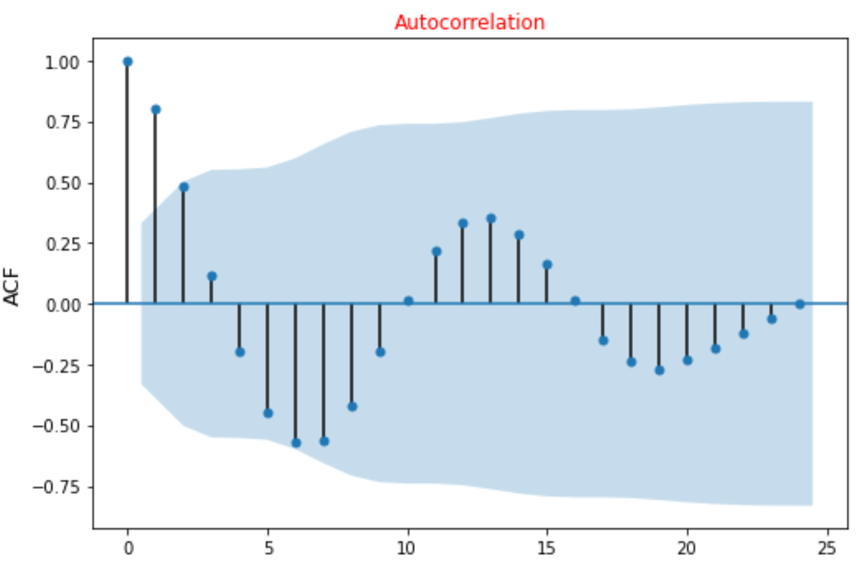
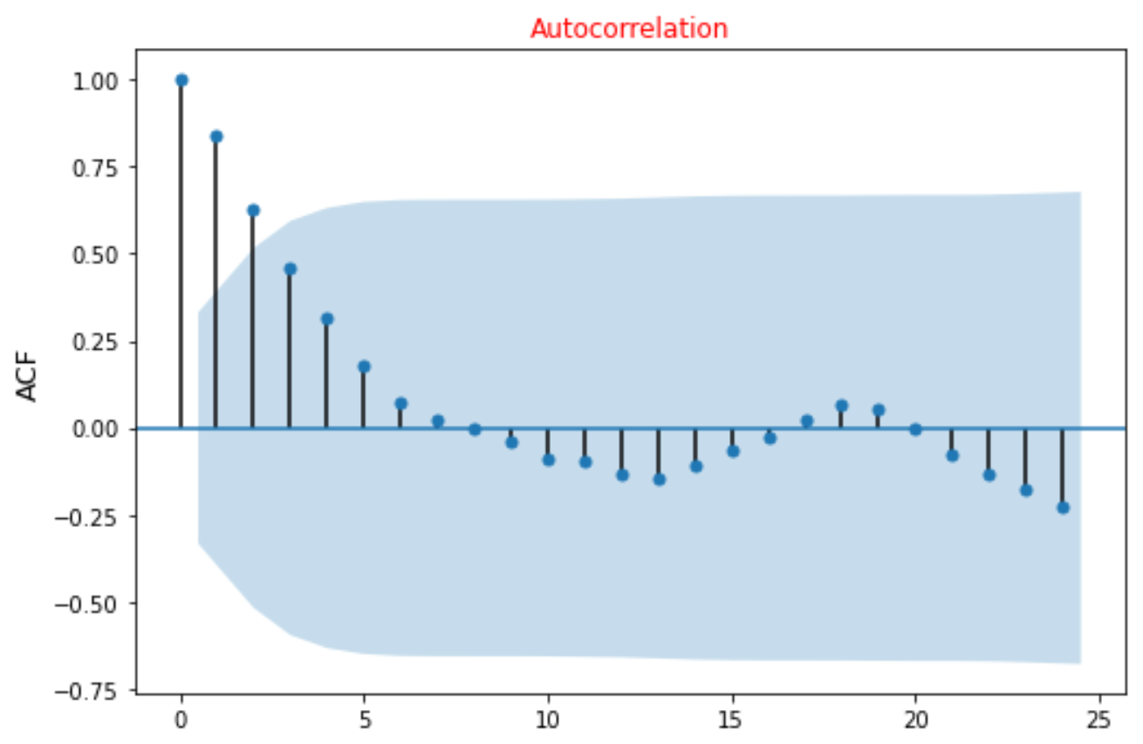
 | Single-Family Group | Duplex Group | Multi-Family Group
Daily Usage
Trend
Seasonal
Resid
Not a white noise, but non-stationary time series
Notes:
Check trend
Usage trend in commercial, industrial and irrigation groups are slightly different. But all have almost a trend with a negative slope
Check white noise
All three non-residential time series were not a white noise
Check stationary
Time series dataset is stationary if its statistical features don't change over time (constant mean, variance, and covariance)
All three non-residential time series were Not stationary based on Dicky-Fuller Test

Slide 9
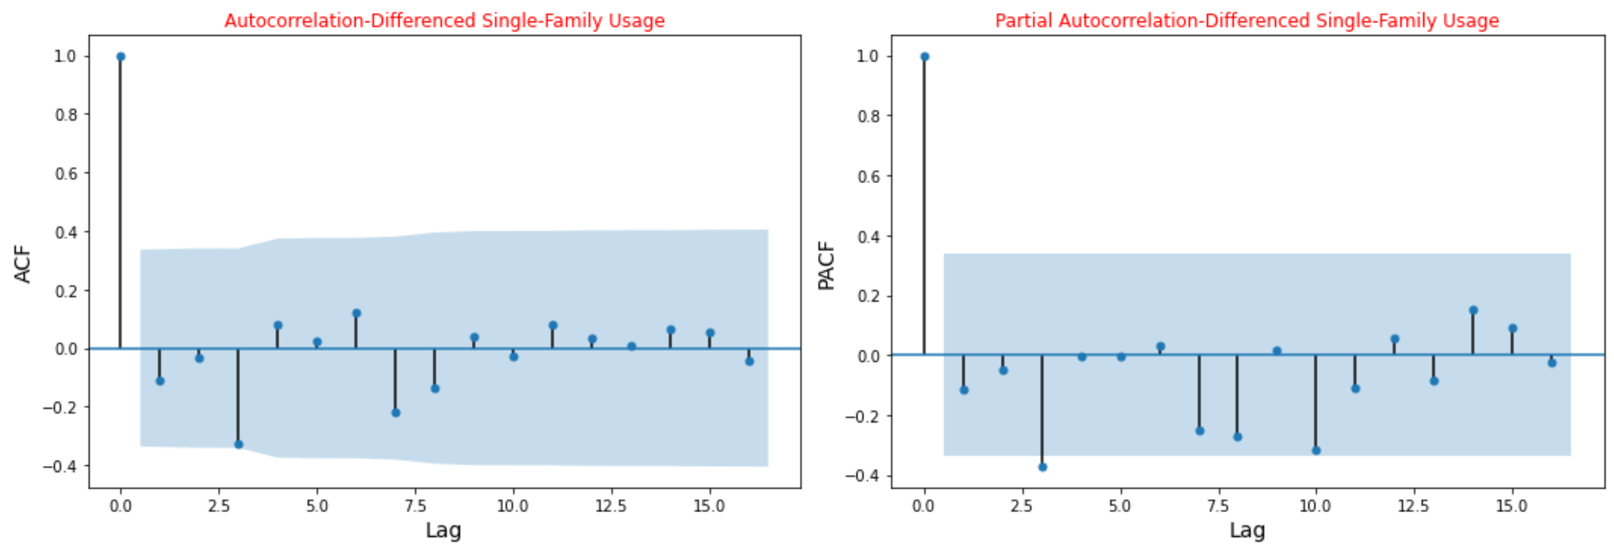
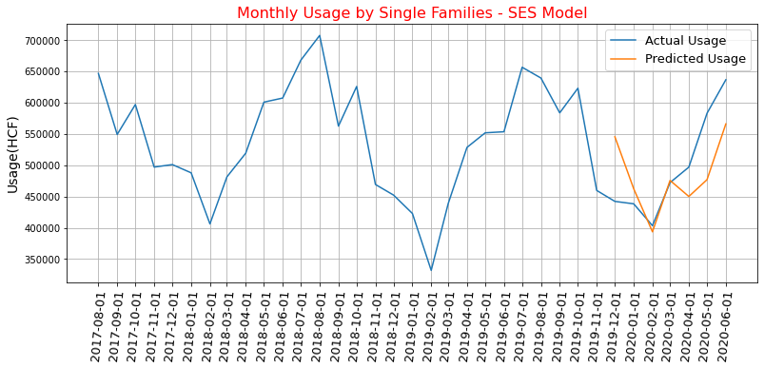
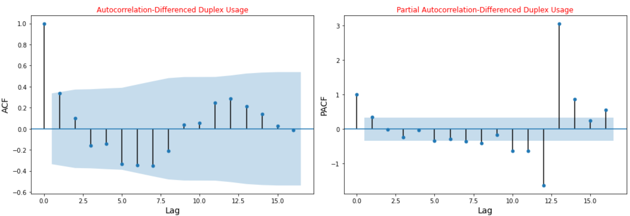
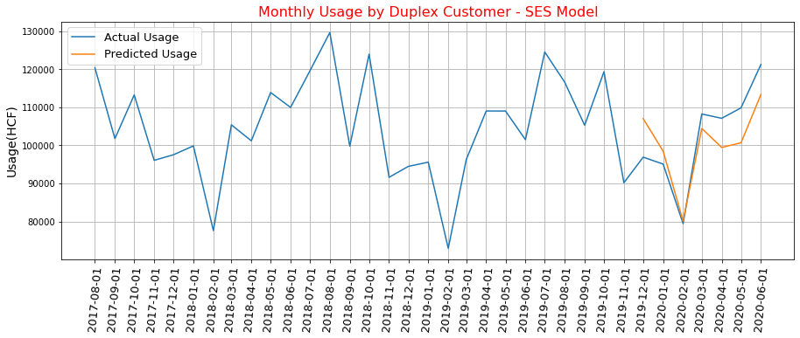
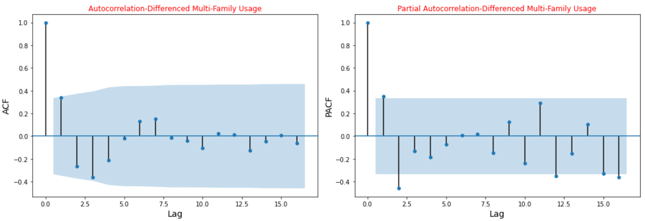
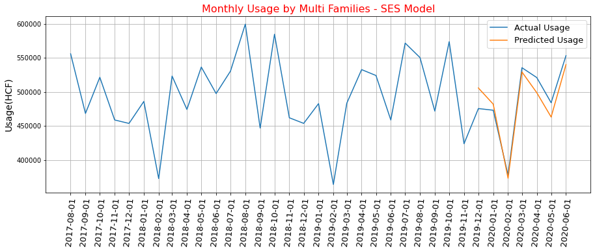
Single-Family Group
Duplex Group
Multi-Family Group
Notes:
usage difference of order one became staionary.

Slide 10
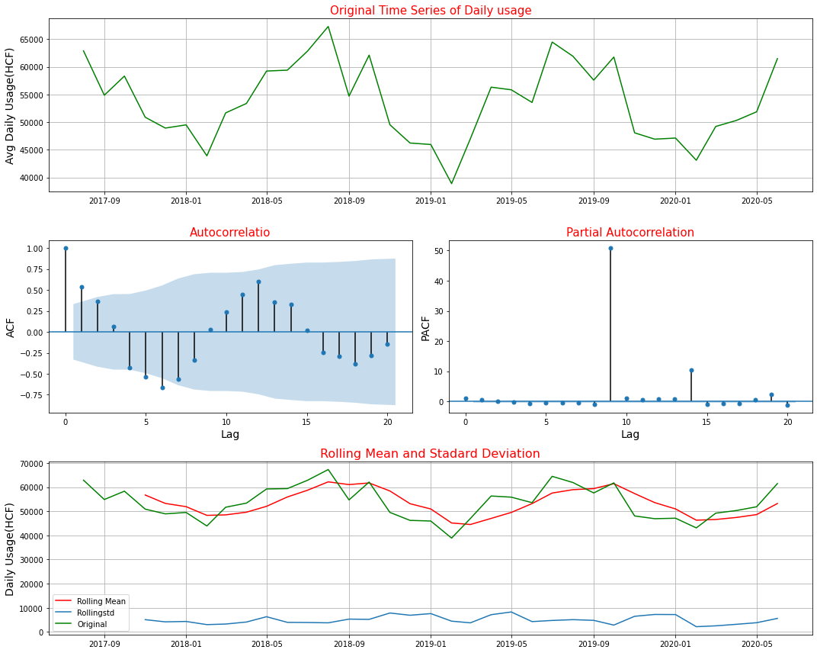
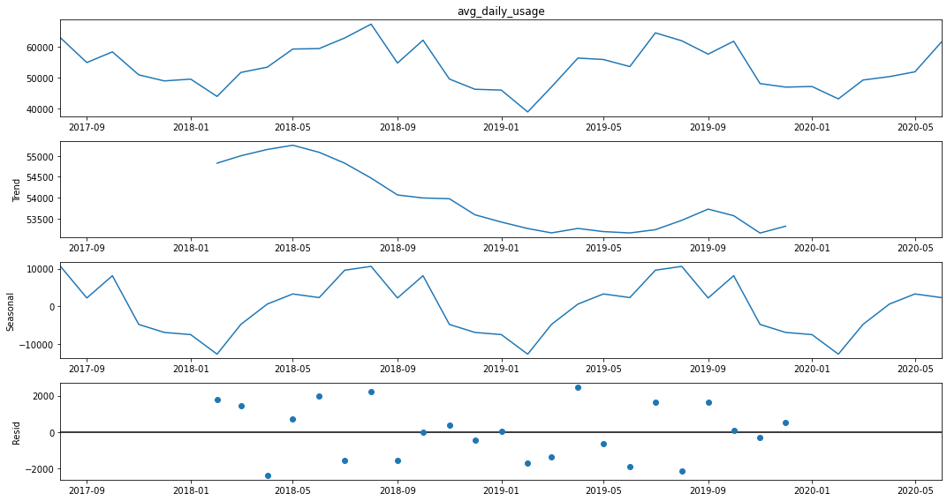
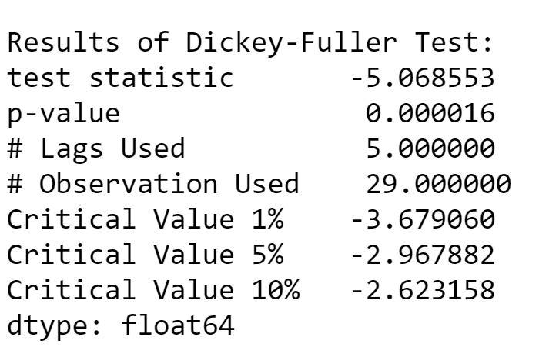
Key Findings on Daily Usage by All Customers
Daily Usage
Trend
Seasonal
Resid
Stationary Time Series

Slide 11
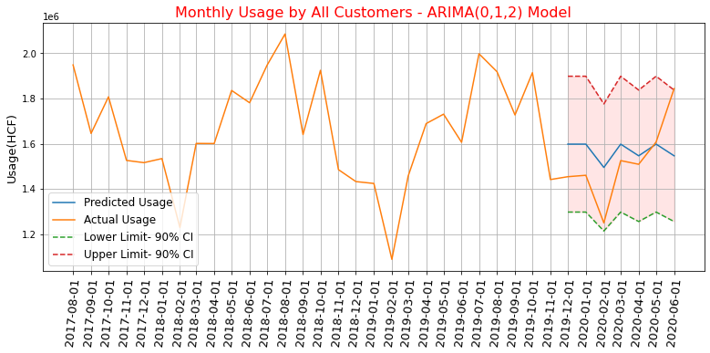
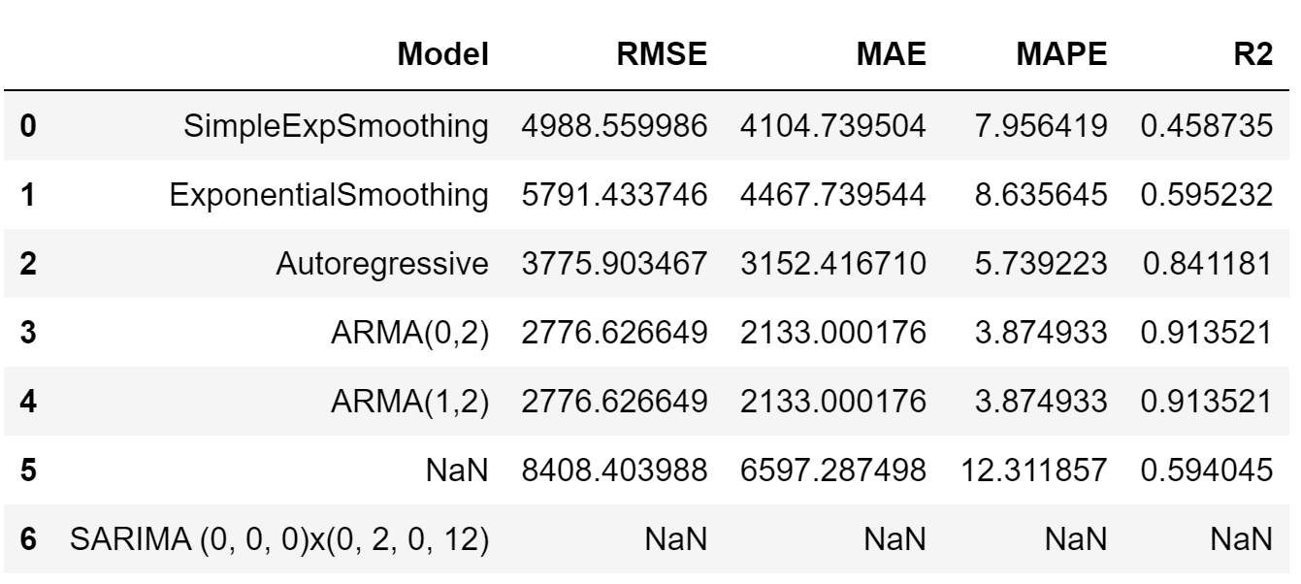
Prediction of Usage by all Customers

Slide 12
Data Wrangling

Slide 13

How Much Water Used in each Month? (based on the Records of Water Meter )
How many days elapsed? Read Days
How much usage is recorded since last meter read? Water Usage
Previous Read Date
Associated Read Date
Notes:
Read Date: Date that water meter was read to record water used since previous read date
Read Days:
Number of days that have elapsed between the associated read date and the previous read date.
Previous Read date:
Calculated from subtracting Read Days from Read Date
Water Usage:
How much water use was recorded since the last meter read (in hcf)

Slide 14
How Much Water Used in each Month?
How many days elapsed? Read Days: 55 days
How much usage is recorded since last meter read? Water Usage: 26 hcf
Previous Read Date
Mar 16, 2020
Associated Read Date
May 10, 2020
Which months are there between previous and associated read dates?
Month Start: Mar 1, 2020 | Month Start: Apr 1, 2020 | Month Start: May 1, 2020
Notes:
Read date: Date that water meter was read to record water used since previous read date

Slide 15
How Much Water Used in each Month?
How many days elapsed? Read Days: 55 days
How much usage is recorded since last meter read? Water Usage: 26 hcf
Previous Read Date
Mar 16, 2020
Associated Read Date
May 10, 2020
How many days should be counted in each month?
Month Start: Mar 1, 2020 | Month Start: Apr 1, 2020 | Month Start: May 1, 2020
Days to count: 16 | Days to count: 30 | Days to count: 9

Slide 16
How Much Water Used in each Month?
How many days elapsed? Read Days: 55 days
How much usage is recorded since last meter read? Water Usage: 26 hcf
Previous Read Date
Mar 16, 2020
Associated Read Date
May 10, 2020
How much usage should be counted in each month?
Month Start: Mar 1, 2020 | Month Start: Apr 1, 2020 | Month Start: May 1, 2020
Days to count: 16 | Days to count: 30 | Days to count: 9
Usage to count: (26/55)*16= 7.56 | Usage to count: 14.18 | Usage to count: 4.25
Notes:
Read date: Date that water meter was read to record water used since previous read date

Slide 17
How Much Water Used in each Month?
How many days elapsed? Read Days: 55 days
How much usage is recorded since last meter read? Water Usage: 26 hcf
Previous Read Date
Mar 16, 2020
Associated Read Date
May 10, 2020
Month Start: Mar 1, 2020 | Month Start: Apr 1, 2020 | Month Start: May 1, 2020
Days to count in March: 16 | Days to count in April: 30 | Days to count in May: 9
Usage to count in March: 7.56 | Usage to count in April: 14.18 | Usage to count in May: 4.25
Algorithm
Notes:
Usage to count in March: (26/55)*16= 7.56

Slide 18
Read date minus Read days
Previous Read date
Find month(s) between Previous date and Read date
Set as index of row
Extract month and year of index for each row
Assign as two columns to df
Build a datetime from extracted year and month
Assign as month_start
Extract # days in month, from month and year columns
Assign as days_in_month
Build a datetime from extracted year and month
Assign as month_start
Extract # days in month, from month and year columns
Assign as days_in_month
Days in month - (Previous Read date – month start date)
Set as previous_read_date_to_month_end
Read date – month start date
Set as month_start_to_read_date
Days in month
Month Start | Previous Read Date | Month End | Read Date
 | previous_read_date_to_month_end
read_date_to_month_start
days_to_count_in_period

Slide 19
IF | Then ‘days_to_count_in_period’ will be
previous_read_date_to_month_end <= days in month | previous_read_date_to_month_end
previous_read_date_to_month_end > days in month & read_date_to_month_start >= days in month | Days in month
previous_read_date_to_month_end > days in month & read_date_to_month_start < days in month | read_date_to_month_start

Slide 20
Examples of the algorithm application

Slide 21
Days in March = 31
Month Start Mar 1,2020 | Previous Read Date March 16, 2020 | Month End | Read Date May 10, 2020
 | previous_read_date_to_month_end 16 days
read_date_to_month_start 70
previous_read_date_to_month_end <= days in month (16 < = 31)
Month Start | days_to_count_in_period
2020-03-01 | 16
Days in April = 30
Month Start April 1, 2020 | Previous Read Date March 16, 2020 | Month End | Read Date May 10, 2020
 | previous_read_date_to_month_end 30-(-16) = 46 days
read_date_to_month_start 39
previous_read_date_to_month_end > days in month (46> 30) & read_date_to_month_start >= days in month (39 >= 30)
Month Start | days_to_count_in_period
2020-04-01 | 30
Days in May = 31
Month Start May 1, 2020 | Previous Read Date March 16, 2020 | Month End | Read Date May 10, 2020
 | previous_read_date_to_month_end 31-(-46) = 77 days
Read_date_to_month_start 9 days
previous_read_date_to_month_end < days in month (77 > 31) & read_date_to_month_start < days in month (9 < 30)
Month Start | days_to_count_in_period
2020-05-01 | 9

Slide 22
Days in March = 31
Month Start Mar 1,2020 | Previous Read Date March 16, 2020 | Month End | Read Date May 1, 2020
 | previous_read_date_to_month_end 16 days
read_date_to_month_start 56
previous_read_date_to_month_end <= days in month then (16 < = 56)
Month Start | days_to_count_in_period
2020-03-01 | 16
Days in April = 30
Month Start April 1, 2020 | Previous Read Date March 16, 2020 | Month End | Read Date May 1, 2020
 | previous_read_date_to_month_end 30-(-16) = 46 days
read_date_to_month_start 30
previous_read_date_to_month_end > days in month (46> 30) & read_date_to_month_start >= days in month (30 >= 30)
Month Start | days_to_count_in_period
2020-04-01 | 30
Days in May = 31
Month Start May 1, 2020 | Previous Read Date March 16, 2020 | Month End | Read Date May 1, 2020
 | previous_read_date_to_month_end 31-(-46) = 77 days
Read_date_to_month_start 0 days
previous_read_date_to_month_end < days in month (77 > 31) & read_date_to_month_start < days in month (9 < 30)
Month Start | days_to_count_in_period
2020-05-01 | 0

